Slide 1

SOCIONICS
All slides are copyrighted by Jack Oliver Aaron of the World Socionics Society
A CRASH COURSE

Slide 2
10. DELTA
All slides are copyrighted by Jack Oliver Aaron of the World Socionics Society

Slide 3
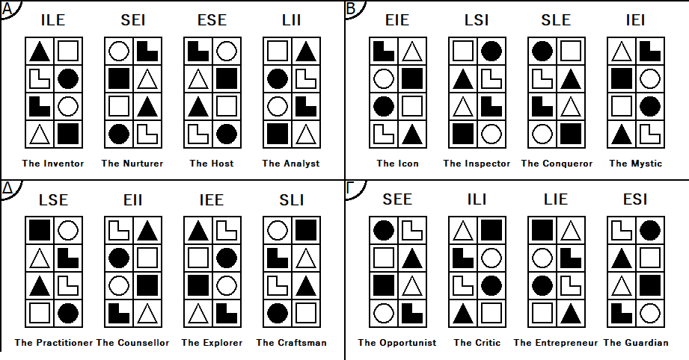
SO FAR
All slides are copyrighted by Jack Oliver Aaron of the World Socionics Society
Information Elements
Information Metabolism
Functions
Types
Alphas
Betas
Gammas

Slide 4
SO FAR
All slides are copyrighted by Jack Oliver Aaron of the World Socionics Society
Information Elements
Information Metabolism
Functions
Types
Alphas
Betas
Gammas
Deltas

Slide 5
DELTA VALUES
All slides are copyrighted by Jack Oliver Aaron of the World Socionics Society
All Valued Elements are Questioning.
Understanding people in all their nuances, and their capacity for ‘good’
Exploring personal potential and how one can develop over time
Learning and practising new skills for continuous personal growth
Being grounded, wanting to do a ‘good job’ and not losing sense of self

Slide 6
DELTA TABOOS
All slides are copyrighted by Jack Oliver Aaron of the World Socionics Society
All Neglected Elements are Conclusive.
Being certain and uncompromising in one’s opinions
Losing one’s friendships in pursuit of power, notoriety and influence
Not wanting to learn or change oneself, seeking to change others instead
Being dramatic and confrontational rather than trying to understand

Slide 7
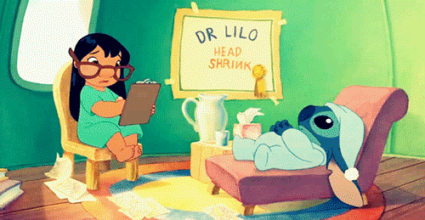
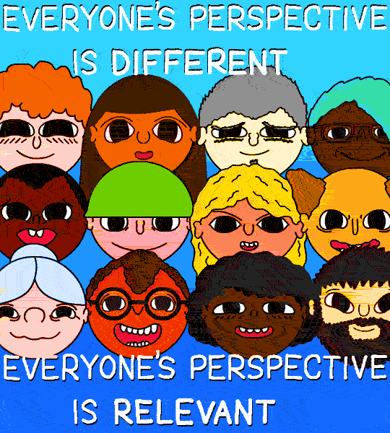
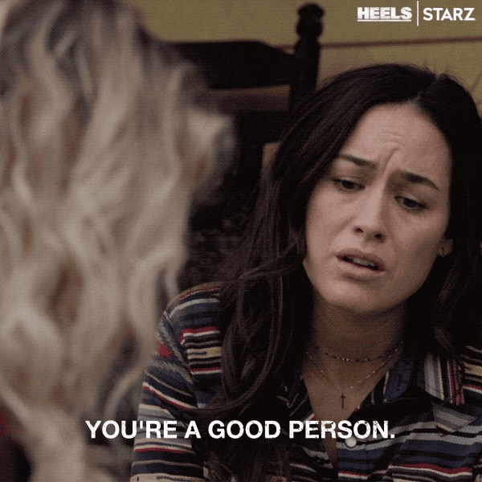
DELTA HUMANITARIANS
All slides are copyrighted by Jack Oliver Aaron of the World Socionics Society
People have untapped potential Listen and give others a chance Explore people’s perspectives Imagine the best that one can be
The Counsellor - EII
The Explorer - IEE

Slide 8

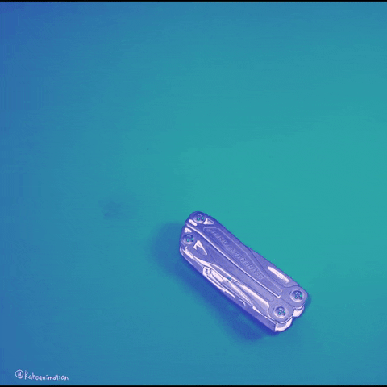
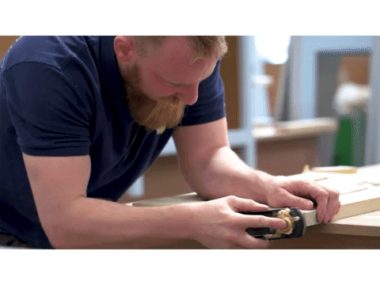
DELTA REALISTS
All slides are copyrighted by Jack Oliver Aaron of the World Socionics Society
Do the best job you can Practice makes perfect Test, observe and learn Maintain high quality output
The Practitioner - LSE
The Craftsman - SLI

Slide 9
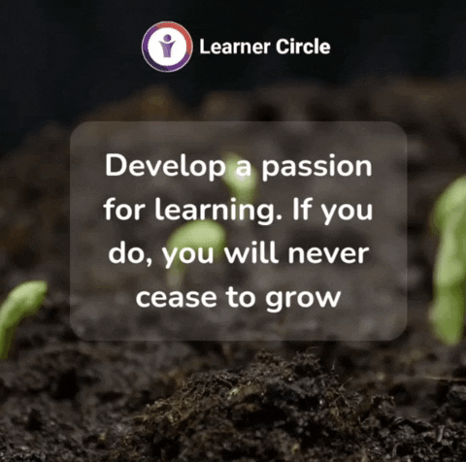
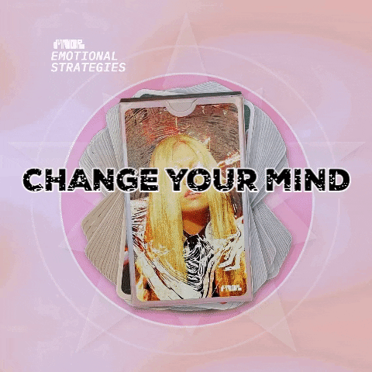
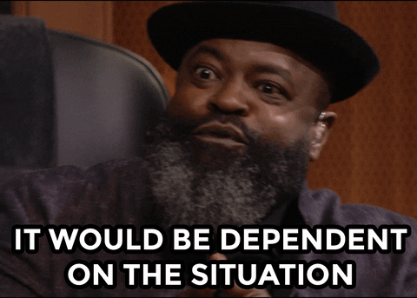
DELTA ENERGISERS
All slides are copyrighted by Jack Oliver Aaron of the World Socionics Society
Be open to all new information Every situation is different Keep learning and broadening horizons Grow and maximise inner potential
The Practitioner - LSE
The Explorer - IEE

Slide 10

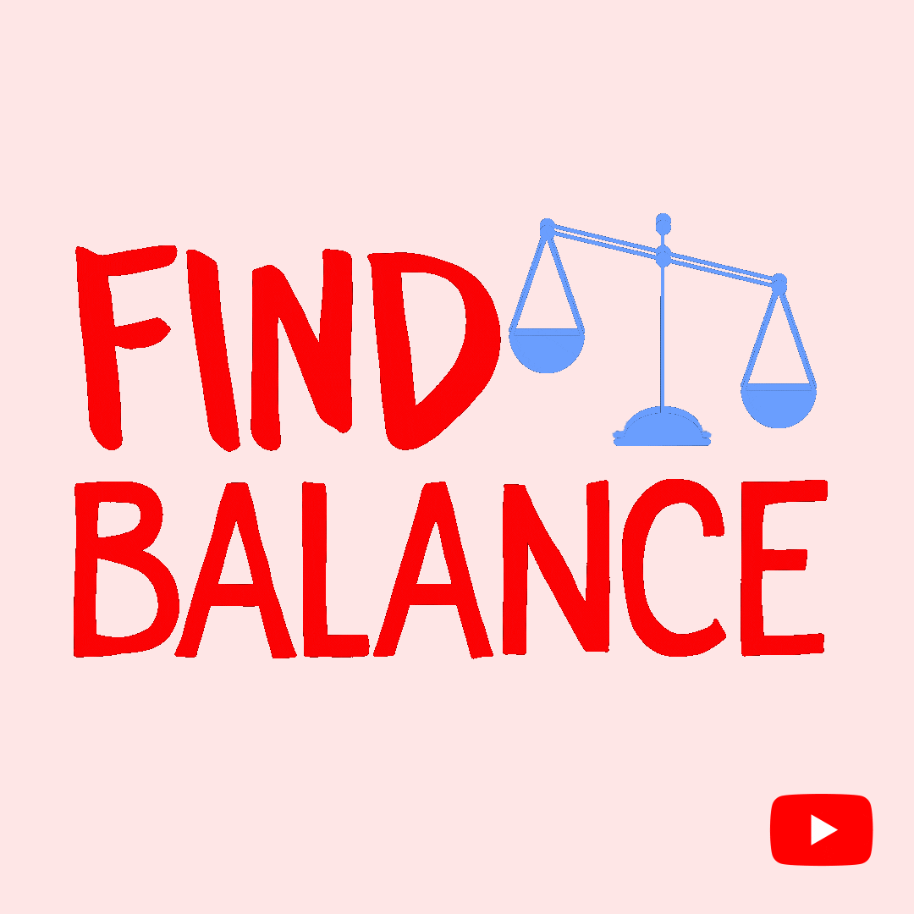
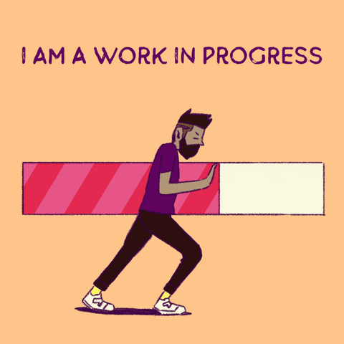
DELTA INTEGRATORS
All slides are copyrighted by Jack Oliver Aaron of the World Socionics Society
Do what feels right and be true to yourself Be sincere, modest, and accepting Accept yourself as a work in progress Turn the other cheek, harmonise relations
The Counsellor - EII
The Craftsman - SLI

Slide 11
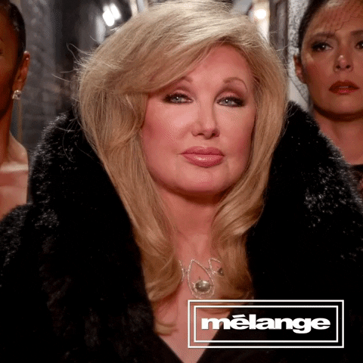
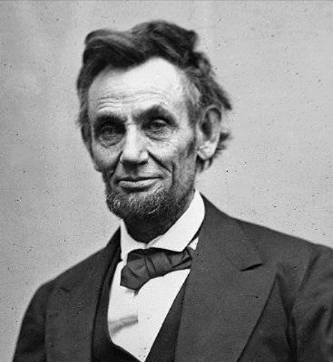
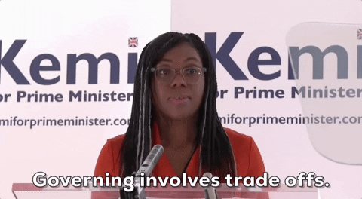
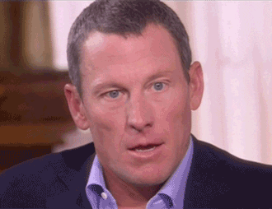

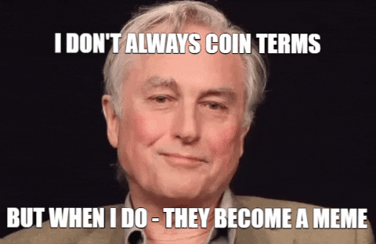
LOGICAL SENSORY ENERGISER - “THE PRACTITIONER”
All slides are copyrighted by Jack Oliver Aaron of the World Socionics Society

Slide 12
EGO BLOCK
All slides are copyrighted by Jack Oliver Aaron of the World Socionics Society
All about operating as efficiently they can Highly practical and pragmatic Finds the processes that work best Best at observing data and applying it Hands on in attention to process Pursues high quality and minimum waste Normally calm, relaxed and supportive Good at operating self-sufficiently
Notes:
Mike Rowe P1+S2: https://www.youtube.com/watch?v=vwu3qscFyOA
FrugalGreenGirl P1+S2: https://www.youtube.com/watch?v=N4TfYOoGzkw

Slide 13
SUPER-EGO BLOCK
All slides are copyrighted by Jack Oliver Aaron of the World Socionics Society
Matter-of-fact in communication Recognises need to be polite and social Can be friendly and adaptive to the mood Prefer to be factual and straightforward Grounded in their present observations Sceptical of anything being predestined Trust in what they can see and practise Struggle with long-term predictions
Notes:
Mike Rowe E3+T4: https://www.youtube.com/watch?v=CVEuPmVAb8o
FrugalGreenGirl E3+T4: https://www.youtube.com/watch?v=xV7gAxvbozU

Slide 14
SUPER-ID BLOCK
All slides are copyrighted by Jack Oliver Aaron of the World Socionics Society
Fact-oriented, lack subjective inner world Relationships can feel transactional Unsure of what really matters to them Welcome insight into their inner intentions Interested in learning what is possible Look to broaden horizons, but lack depth Try to account for everything in planning Give people benefit of the doubt
Notes:
Mike Rowe R5: https://www.youtube.com/watch?v=22VqOj4MtMs&t=220s
Roger Corman I6: https://www.youtube.com/watch?v=UjEghH0xrYo

Slide 15
ID BLOCK
All slides are copyrighted by Jack Oliver Aaron of the World Socionics Society
Prefer best process for situation to rules Prioritise practicality/common sense Utilise structures, but only if practical Quick to update systems if not working Seemingly tireless, a ‘work horse’ Able to get a lot of things done Often exercising and keeping fit Assertive if they need to be
Notes:
Richard Dawkins L7: https://www.youtube.com/watch?v=6u8gAV7om_g
Abraham Lincoln F8: https://www.youtube.com/watch?v=1qjtugr2618

Slide 16
DOMINATION
All slides are copyrighted by Jack Oliver Aaron of the World Socionics Society
Focused on what works pragmatically Insist on not being tied down to an ideology Will refuse to simplify data to a structure Cut red tape to make improvements Provide all the facts when explaining
Notes:
Richard Dawkins P1>L7: https://www.youtube.com/watch?v=ZC47livfpFM&t=82s

Slide 17
MASKING
All slides are copyrighted by Jack Oliver Aaron of the World Socionics Society
Communicate to inform, not entertain Realise that they need to engage people Think it is bad form to upset people Will be a friendly, good sport for others
Notes:
Mike Rowe P1 -> E3: https://www.youtube.com/watch?v=kLyqdOa_aO8
Chuck Norris P1 -> E3: https://www.youtube.com/watch?v=fqvFMwGdJps
Mitt Romney P1 -> E3: https://www.youtube.com/watch?v=02zTj_xGx60

Slide 18
STRUGGLE
All slides are copyrighted by Jack Oliver Aaron of the World Socionics Society
Think they need to be palatable to others Find this inaccurate and disingenuous Want to be sincere and accurate Appreciate being understood for who they are Freed from the act by intimate relationships
Notes:
Abraham Lincoln E3>R5: https://www.youtube.com/watch?v=wxj6_9hH9N4
George H.W Bush E3>R5: https://www.youtube.com/watch?v=u1Yc2mMV5kE

Slide 19
DISTRACTION
All slides are copyrighted by Jack Oliver Aaron of the World Socionics Society
Want a close, intimate relationship Can lay down rules if unsure of competence May smother individuality as a result Benefit from help in trusting people to grow

Slide 20
MASTERY
All slides are copyrighted by Jack Oliver Aaron of the World Socionics Society
Highly conditioned to the local, present day Operate at high energy and sustain health Mix physical prowess with wholesomeness Expertly handle high levels of pressure Able to quickly manage present resources
Notes:
Chuck Norris S2<F8: https://www.youtube.com/watch?v=t_0GYGmPwFQ
Cathy Freeman S2<F8: https://www.youtube.com/watch?v=xNmuyxlZ9Kk

Slide 21
GROWTH
All slides are copyrighted by Jack Oliver Aaron of the World Socionics Society
Grow to be more creative and open to ideas Become more open, less pushy over time Giving people more freedom can backfire Regress to being tougher, more authoritarian
Notes:
Jan Smuts F8 -> I6: https://www.youtube.com/watch?v=JIRfhrTE9N4
William F. Buckley F8 -> I6: https://www.youtube.com/watch?v=nYymnxoQnf8

Slide 22
SUBSTITUTION
All slides are copyrighted by Jack Oliver Aaron of the World Socionics Society
Look at specifics, not the deeper meaning Focus on process, rather than what it’s about Think doing a ‘good job’ will achieve goals Need responsibility within a clear time frame
Notes:
Richard Dawkins T4 -> S2: https://www.youtube.com/watch?v=17Bcwg5gByU
Richard Dawkins T4 -> S2: https://www.youtube.com/watch?v=5of4A7DGQvw&t=73s

Slide 23
HUBRIS
All slides are copyrighted by Jack Oliver Aaron of the World Socionics Society
Blind to how the future will turn out Yet want to try new plans and ideas Plan for every possibility at great effort Think anything is possible if they work at it Ultimately fail to see what was inevitable
Notes:
Joseph II, Holy Roman Emperor T4<I6: https://www.youtube.com/watch?v=hLqrwhRww94
Richard Dawkins T4<I6: https://www.youtube.com/watch?v=lFG5qo7HbIM

Slide 24
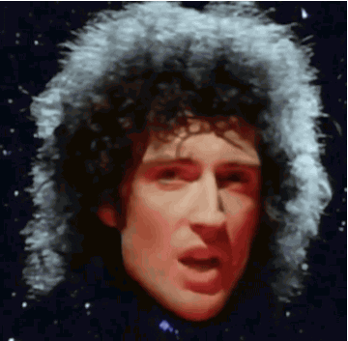
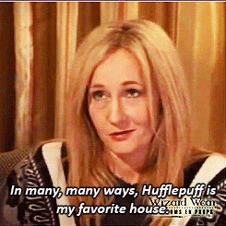
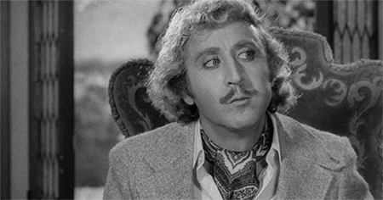
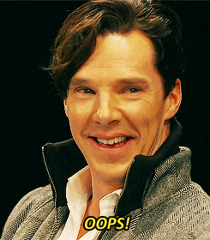
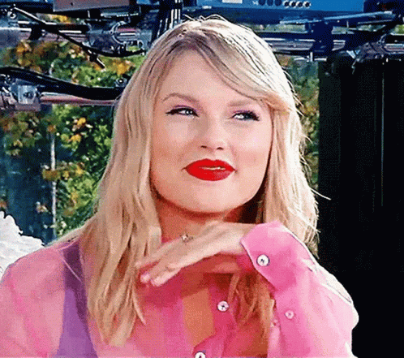
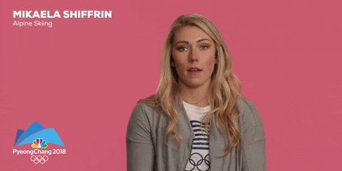
ETHICAL INTUITIVE INTEGRATOR - “THE COUNSELLOR”
All slides are copyrighted by Jack Oliver Aaron of the World Socionics Society

Slide 25
EGO BLOCK
All slides are copyrighted by Jack Oliver Aaron of the World Socionics Society
Driven to form intimate relationships Want to truly understand other people Highly evaluative of people’s intentions See within to see someone’s soul Often willing to give others a chance Likes to speculate about people Places hope in the potential of people Can be disappointed when not fulfilled
Notes:
Carl Rogers R1+I2: https://www.youtube.com/watch?v=o0neRQzudzw
Charlie Kaufman R1+I2: https://www.youtube.com/watch?v=o0neRQzudzw

Slide 26
SUPER-EGO BLOCK
All slides are copyrighted by Jack Oliver Aaron of the World Socionics Society
Consults how they feel in each situation Avoid impartial, rule-based assessments Can create and maintain structures Can use frameworks to understand things Naturally very gentle and forgiving Struggle to read power dynamics Have difficulty taking action on decisions Struggle to create and enforce boundaries
Notes:
Lindsay Shepherd L3+F4: https://www.youtube.com/watch?v=hGI721w66to

Slide 27
SUPER-ID BLOCK
All slides are copyrighted by Jack Oliver Aaron of the World Socionics Society
Lack confidence in applying themselves Doubt own competence, feel an imposter Work themselves hard to do a good job Seek experts whose advice they trust Need to harmonise their relationships Require inner calm and peace of mind Can be particular over balance of details May stress over aesthetic appearance
Notes:
Mikaela Shiffrin P5: https://www.youtube.com/watch?v=x8v8YHm0vUY
Marcus Aurelius S6: https://www.youtube.com/watch?v=FsVY-Y2PSSk

Slide 28
ID BLOCK
All slides are copyrighted by Jack Oliver Aaron of the World Socionics Society
Takes time to warm up to people Unlikely to manage group mood Genuinely warm with people they like Very sincere, perhaps direct at times Inclined to deep self-reflection Often know what is going to happen Can be highly spiritual, look for meaning Remain open to changing their mind
Notes:
Taylor Swift E7+T8: https://www.youtube.com/watch?v=zyB2EPEzQjU

Slide 29
DOMINATION
All slides are copyrighted by Jack Oliver Aaron of the World Socionics Society
Wants to be sincere to personal attitudes Insistent on being true to themselves Will not sacrifice their soul to be popular Do what they feel is right, even if unpopular See true intentions behind outward displays
Notes:
Hayao Miyazaki R1>E7: https://www.youtube.com/watch?v=ngZ0K3lWKRc
J. K. Rowling R1>E7: https://www.youtube.com/watch?v=7BdVHWz1DPU&t=300s

Slide 30
MASKING
All slides are copyrighted by Jack Oliver Aaron of the World Socionics Society
Focused on their personal attitudes Find structures too impersonal and rigid Want to treat different people differently Feel they must justify decisions with rules
Notes:
Neil Gorsuch R1 -> L3: https://www.youtube.com/watch?v=pkPTVoeQSGs

Slide 31
STRUGGLE
All slides are copyrighted by Jack Oliver Aaron of the World Socionics Society
Want to feel competent in what they do Lacks confidence in their competence Turn to reliance on clear rules and systems Not pragmatic or common-sense driven Need to meet experts who can advise them
Notes:
Hayao Miyazaki L3>P5: https://www.youtube.com/watch?v=1zi7jIZkS68&t=808s
Justine Musk L3>P5: https://www.youtube.com/watch?v=JF-KrSnixr4&t=443s
Marcus Aurelius L3>P5: https://www.youtube.com/watch?v=q_YJzCEaxEg

Slide 32
DISTRACTION
All slides are copyrighted by Jack Oliver Aaron of the World Socionics Society
Normally accepting of practical advice Occasionally affected by strong emotions Becomes uninterested in practical help Can become emotional and irrational

Slide 33
MASTERY
All slides are copyrighted by Jack Oliver Aaron of the World Socionics Society
Prone towards deep mental reflection Also highly open-minded to alternatives Results in ongoing queries and consideration Highly insightful, knowing what will happen Yet, still giving things a chance despite this
Notes:
Hayao Miyazaki I2<T8: https://www.youtube.com/watch?v=R0noElyH5hw
Taylor Swift I2<T8: https://www.youtube.com/watch?v=vNoKguSdy4Y
Hayao Miyazaki I2<T8: https://www.youtube.com/watch?v=1zi7jIZkS68&t=66s

Slide 34
GROWTH
All slides are copyrighted by Jack Oliver Aaron of the World Socionics Society
In their heads by default Grows over time to be more present Engages in safe, relaxing physical activities Mentally detaches again when stressed
Notes:
Gene Wilder T8 -> S6: https://www.youtube.com/watch?v=Gj1BvTqdzmU

Slide 35
SUBSTITUTION
All slides are copyrighted by Jack Oliver Aaron of the World Socionics Society
Don’t see power dynamics May give people multiple chances Can be taken advantage of May avoid rather than enforce boundaries
Notes:
Taylor Swift F4 -> I2: https://www.youtube.com/watch?v=Ij_RwjupDvc

Slide 36
HUBRIS
All slides are copyrighted by Jack Oliver Aaron of the World Socionics Society
Blind to power dynamics and physical threats Yet need environment to be calm and stable Try to maintain a relaxing physical space Cannot assert themselves and protect space May become overwhelmed and withdraw
Notes:
Nicholas II of Russia F4<S6: https://www.youtube.com/watch?v=sS6ErQefA9w&t=1679s

Slide 37
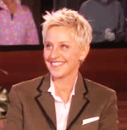
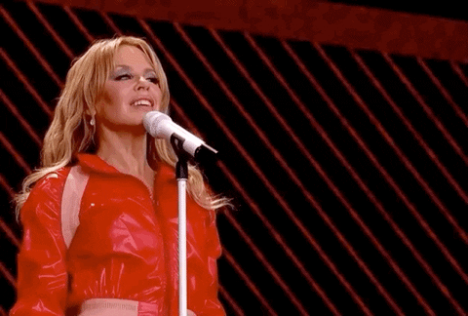
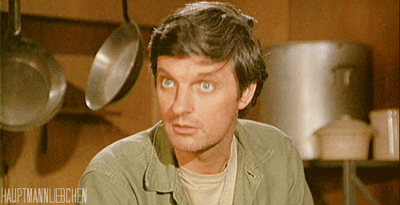
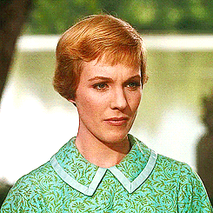

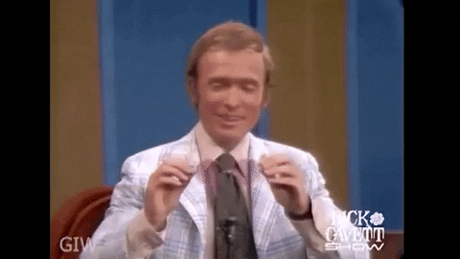
INTUITIVE ETHICAL ENERGISER - “THE EXPLORER”
All slides are copyrighted by Jack Oliver Aaron of the World Socionics Society

Slide 38
EGO BLOCK
All slides are copyrighted by Jack Oliver Aaron of the World Socionics Society
All about exploring different perspectives Interested in different kinds of people Want to unlock their own potential Open to all ways of thinking Quick to build close relationships Good at understanding people Great at connecting people together Evaluate how they feel towards others
Notes:
Alan Alda I1+R2: https://www.youtube.com/watch?v=qulq_n5zbTs
Jon Ronson I1+R2: https://www.youtube.com/watch?v=dS-uqDgqx3I

Slide 39
SUPER-EGO BLOCK
All slides are copyrighted by Jack Oliver Aaron of the World Socionics Society
Not naturally assertive Much prefer to keep things open Need a personal judgement to be firm Can exercise aggression in short bursts Struggle to identify logical inconsistencies Averse to deriving general rules from data Tend to be erratic, easily changing mind Finds structure to be limiting
Notes:
Jon Ronson F3: https://www.youtube.com/watch?v=7HAkJZc2zVU
George Orwell L4: https://www.youtube.com/watch?v=YtCT3hYQ0wc

Slide 40
SUPER-ID BLOCK
All slides are copyrighted by Jack Oliver Aaron of the World Socionics Society
Often forget day-to-day details Chase new interests, losing stability Tend to be forgiving and tolerant Benefit from a calming influence Eagerly learn and practise new skills Want to become self-sufficient Become more capable over time Like to maximise personal development
Notes:
Ellen Degeneres S5: https://www.youtube.com/watch?v=2o8Kn5UjpUs
Alan Alda P6: https://www.youtube.com/watch?v=r4JrcVEkink

Slide 41
ID BLOCK
All slides are copyrighted by Jack Oliver Aaron of the World Socionics Society
Believe that most things are possible Can see the weight or potential of ideas Avoid narrowing any options Tend to be non-committal to decisions Highly likeable, take it for granted Tend to be outwardly expressive Easily warm up the room Not interested in controlling the mood
Notes:
Vaclav Havel T7+E8: https://www.youtube.com/watch?v=81BCs5Okltc

Slide 42
DOMINATION
All slides are copyrighted by Jack Oliver Aaron of the World Socionics Society
Wants to maximise possibilities Insistent on exploring ideas with potential Will not be dissuaded from trying ideas out Only filter out possibilities with low potential May try bad ideas, just in case they work
Notes:
Scott Bradlee I1>T7: https://www.youtube.com/watch?v=Fh6hfpbs2GY

Slide 43
MASKING
All slides are copyrighted by Jack Oliver Aaron of the World Socionics Society
Strongly prefer ‘out of the box’ approaches Dislike the direct approach but will if needed Prefer to step back, let possibilities flourish Constraints force them to be more forceful
Notes:
George Orwell I1 -> F3: https://www.youtube.com/watch?v=jPDKY16dEgE&t=95s
Ellen Degeneres I1 -> F3: https://www.youtube.com/watch?v=8t7P2XmaQmQ

Slide 44
STRUGGLE
All slides are copyrighted by Jack Oliver Aaron of the World Socionics Society
Reluctantly adapt to worldly pressures See the world as requiring them to be tough Feel they have to become more disciplined Desire people who are calm and laid back Freed by comforting, maintained surroundings
Notes:
Vaclav Havel F3>S5: https://www.youtube.com/watch?v=CfSoph1lkHg
Michael J. Fox F3>S5: https://www.youtube.com/watch?v=fmkZAV4bjvE&t=230s
Julie Andrews F3>S5: https://www.youtube.com/watch?v=tmF1kHwdBSM

Slide 45
DISTRACTION
All slides are copyrighted by Jack Oliver Aaron of the World Socionics Society
Normally in pursuit of hedonic pleasure Become very ascetic when having to focus Neglect their daily needs, not eating, sleeping Need to get through bottleneck to relax again

Slide 46
MASTERY
All slides are copyrighted by Jack Oliver Aaron of the World Socionics Society
Very charming and captivating Can work a room, and bond one-to-one Charming in service of building close bonds Easily win over the people they like Often trusted and respected by all
Notes:
Ellen Degeneres R2<E8: https://www.youtube.com/watch?v=zmSa8n8kzhE

Slide 47
SUBSTITUTION
All slides are copyrighted by Jack Oliver Aaron of the World Socionics Society
Struggle to see structures and formalities Default to personal attitudes and relationships Refuse to become partisan or tied to a view Help their friends regardless of ideology
Notes:
Vaclav Havel L4 -> R2: https://www.youtube.com/watch?v=81BCs5Okltc&t=667s
Ellen Degeneres L4 -> R2: https://www.youtube.com/watch?v=lSZtjol7mJA

Slide 48
GROWTH
All slides are copyrighted by Jack Oliver Aaron of the World Socionics Society
Very likeable, take charisma for granted Acquire knowledge to become competent Lack of consistency limits effectiveness Regress to socialising and people-pleasing
Notes:
Steven Pinker E8 -> P6: https://www.youtube.com/watch?v=x3ScGOYQYEI
Ellen Degeneres E8 -> P6: https://www.youtube.com/watch?v=lCF2IOLHV9Q

Slide 49
HUBRIS
All slides are copyrighted by Jack Oliver Aaron of the World Socionics Society
Blind to how information should be structured Yet want to feel competent and capable Just see and talk about the facts Bastardise theories, lacking a coherence Solutions may fail, unable to pass skills on
Notes:
Steven Pinker L4<P6: https://www.youtube.com/watch?v=cuRohGEgUqc
Steven Pinker L4<P6: https://www.youtube.com/watch?v=VQxJi0COTBo

Slide 50
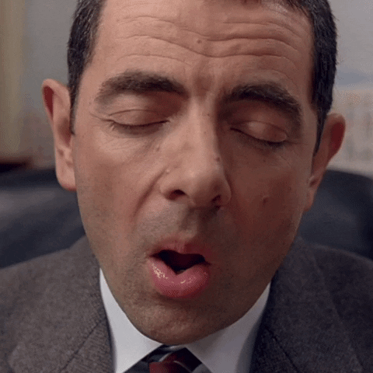
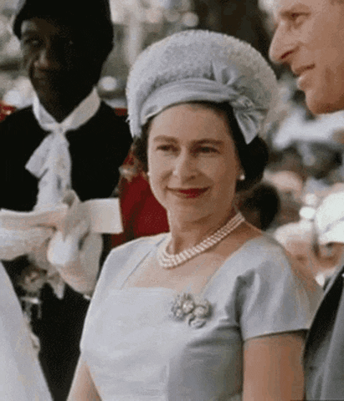
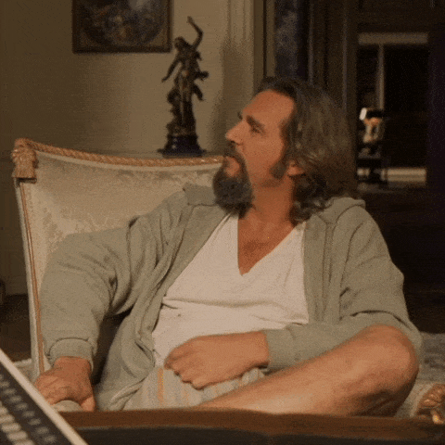
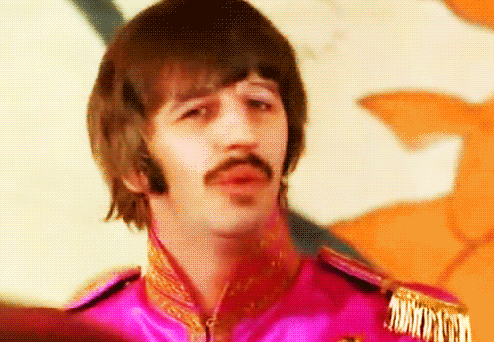
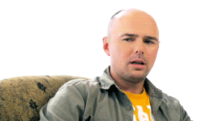
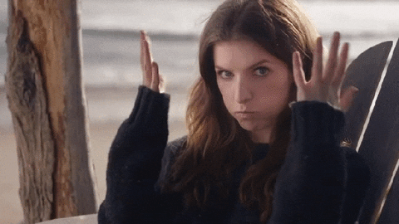
SENSORY LOGICAL INTEGRATOR - “THE CRAFTSMAN”
All slides are copyrighted by Jack Oliver Aaron of the World Socionics Society

Slide 51
EGO BLOCK
All slides are copyrighted by Jack Oliver Aaron of the World Socionics Society
Naturally grounded, down to earth Find flow and conserve their energy Focused on high quality of work Enjoy working without disruption Good at taking in facts to think through Crunches data to form factual opinions Can pass on information when asked Focus on functionality of flow
Notes:
Cheryl Strayed S1: https://www.youtube.com/watch?v=UZwqBs5wmfs&t=20s
Burt Rutan S1+P2: https://www.youtube.com/watch?v=St3scZyyg3k

Slide 52
SUPER-EGO BLOCK
All slides are copyrighted by Jack Oliver Aaron of the World Socionics Society
More in present day than in past or future Able to reflect and think more deeply Prefer to manage things in the present Keep things simple, not dramatic Often dry, expressionless communicators Very simple and unpretentious in style Say what they think even if it unpopular No interest in managing style for others
Notes:
Kimi Raikkone E5+T6: https://www.youtube.com/watch?v=7kIgh-__YeY

Slide 53
SUPER-ID BLOCK
All slides are copyrighted by Jack Oliver Aaron of the World Socionics Society
Have an inertia about trying new things Enjoy being led to new developments Open to the ideas of other people Do not see their own potential Prioritise personal attitudes over emotion Want to be understood by others Form close one-to-one attachments Interested in character and authenticity
Notes:
Benny Andersson I5: https://www.youtube.com/watch?v=OSSQs3HtHcA&t=45s
Rowan Atkinson R6: https://www.youtube.com/watch?v=wq2T1h6tgDY&t=197s

Slide 54
ID BLOCK
All slides are copyrighted by Jack Oliver Aaron of the World Socionics Society
Greatly prefer peace and quiet Can spring into action if necessary If very uncomfortable become assertive Can be outwardly tough and resilient Clear and structured in thinking Use rules to regulate pace of life Easygoing in adapting systems Does not need to settle on ‘the truth’
Notes:
Harrison Ford F7: https://www.youtube.com/watch?v=Ox4SGHHMsZU
Anthony Hopkins L8: https://www.youtube.com/watch?v=IZNMtCXmgBI&t=54s

Slide 55
DOMINATION
All slides are copyrighted by Jack Oliver Aaron of the World Socionics Society
Wants to minimise tension and disruption Insistent on a calm space in which to work Will not be pushed out of their natural pace Only grow assertive when uncomfortable May avoid any unnecessary confrontation
Notes:
Anthony Hopkins S1>F7: https://www.youtube.com/watch?v=GGR-9pxmcts
Rowan Atkinson S1>F7: https://www.youtube.com/shorts/u2jh4_t2Tw4

Slide 56
MASKING
All slides are copyrighted by Jack Oliver Aaron of the World Socionics Society
Strongly prefer to be in the moment Dislike deep reflection but will if needed Prefer to be in their body, rather than the mind Feel they have to worry about uncertain future
Notes:
Burt Rutan S1 -> I3: https://www.youtube.com/watch?v=nwfSENkvJXY&t=24s

Slide 57
STRUGGLE
All slides are copyrighted by Jack Oliver Aaron of the World Socionics Society
When uncertain, can worry about the future See negative experiences, yet to come Feel some bad things are inevitable Desire people who can think outside the box Freed by learning about different perspectives
Notes:
Elizabeth II T3>I5: https://www.youtube.com/watch?v=Lh1-9ww_HmM&t=9s

Slide 58
DISTRACTION
All slides are copyrighted by Jack Oliver Aaron of the World Socionics Society
Normally like being shown new ideas Become very assertive when uncomfortable Put up barriers, shut out suggestions Need to be comfortable again to open up

Slide 59
MASTERY
All slides are copyrighted by Jack Oliver Aaron of the World Socionics Society
Excellent at collating and arranging data Crunches information to turn up new insights Balances pragmatism with structural analysis Builds systems to work better with facts Theories are mere tools to be improved later
Notes:
Temple Grandin P2<L8: https://www.youtube.com/watch?v=-OV9V-HGSEY

Slide 60
SUBSTITUTION
All slides are copyrighted by Jack Oliver Aaron of the World Socionics Society
Inexpressive, dry, factual communicators All substance, no style or sense of occasion Sincere but can be rude/inappropriate Self-sufficient, prefer not to be interrupted
Notes:
Charles Murray E4 -> P2: https://www.youtube.com/watch?v=YsjCBxiY9z0
Elizabeth II E4 -> P2: https://www.youtube.com/watch?v=Lh1-9ww_HmM&t=294s

Slide 61
GROWTH
All slides are copyrighted by Jack Oliver Aaron of the World Socionics Society
Take path to uncovering ‘the truth’ for granted Instead seek intimacy with another person Opening up to a person creates vulnerability Regress to administrative pursuits
Notes:
Elizabeth II L8 -> R6: https://www.youtube.com/watch?v=mBRP-o6Q85s
Elizabeth II L8 -> R6: https://www.youtube.com/watch?v=alY46lqTwtM

Slide 62
HUBRIS
All slides are copyrighted by Jack Oliver Aaron of the World Socionics Society
Blind to public fashions, passions and dramas Yet want to harmonise close relationships Dedicated and stoic in private life May struggle to be popularly accepted Misunderstood as boring, unfeeling or cold
Notes:
Elizabeth II E4<R6: https://www.youtube.com/watch?v=OoVYhJmKB4k&t=160s
Elizabeth E4<R6: https://www.youtube.com/watch?v=kOstTi1DmFU&t=3656s

Slide 63
Any Questions?
All slides are copyrighted by Jack Oliver Aaron of the World Socionics Society
Email Jack at worldsocionics@hotmail.com

